Slide 1
Two Days Online International Training on Research Manuscript Drafting and Publishing-EUDOXIA Writing Research Paper
I
M
Ra
D
Dr. M. S. Kulkarni,
Associate Professor in Demography
Goa Medical College
16-17 May 2020

Slide 2
Outline :
Purpose of research writing
Structure of research paper
Abstract
Introduction
Methods
Results
Discussion
Conclusion

Slide 3
Writing Research paper
Research Paper : Aacademic writing based on original research on a specific problem, analysis and interpretation.
After publication it is called as research article.
Writing Research Paper is Art and Science:
It is science because, the report is based on on sound and robust principles of research methodology. It is an art, since writing is based on clarity, brevity, significance, and organization.
Writing Scientific Paper( Thesis) > Presentation and Style
Notes:
The science of scholarly writing consists of (a) selecting a topic worthy of scholarly research, (b) compliance with a scholarly manual (e.g., APA style); (c) a clear understanding of the mechanics of writing, i.e., proper grammar; and (d) basic adherence to the steps of the scientific method. The art of scholarly writing is more elusive to define but just as essential to a well-written article. The art of writing in a scholarly tone is based on (a) clarity, (b) brevity, (c) significance, (d) eloquence, (e) organization, and (f) overcoming writers’ block.

Slide 4


Need of Writing Research Paper
To communicate research findings with peers
.
1
1
2
Receive academic & professional recognition
Promotion and career advancement
3
4
Unethical if not published

Slide 5
Stages of Writing & Publishing Research Paper
Plan for research writing
Prepare protocol, literature review, Ethical approval, Collect data
Analyze data, prepare tables and graphs
Decide target audience and journal
Refer the instruction for authors & go through the recent issues
Start writing the paper
First Draft, Second Draft
Submit the article electronically as per guidelines of journal

Slide 6
Structure of Research paper
I
M
Ra
D
I
M
Ra
D
Introduction
Method
Result
and
DISCUSSION

Slide 7
Anatomy of Research Paper :
Title Page
Abstract (with Key words)
Introduction (including literature review and conceptual framework)
Material and Methods
Results
Conclusion
Acknowledgements
References
Tables and Graphs
Appendices

Slide 8
Space Requirement
Section | Function | Paper Space | No of words
Abstract, Key words |  | 1 page | 200-250
Introduction | Why did you start? | 1 -2 page | 1000
Methodology | What did you do ? | 2-3 pages | 600
Results | What did you find ? | 2-3 pages | 400
Discussion Conclusion | What does it mean? | 2-3 pages | 1000
References |  | 2-3 pages | 20-30 References
Tables & Diagrams |  | 2-3 pages | 2- 4 Tables 1-2 Diagrams

Slide 9
Abstract :
Brief summary which tells the readers the purpose, significance, study population, research methods, and the main findings, conclusion and implications of your research study.
Abstract gives the first impression about your paper
The editors, reviewers and readers decide next course of action based on your abstract
Use 200-250 words and 5-8 keywords
Start writing the abstract, after completion of witting your paper
Types of abstract : Structured and Unstructured

Slide 10
Structured Abstract :
The abstract should be a concise and precise summary of the paper :
Background
Aim/objective(s)/Hypothesis
Material and Methods
Results
Conclusions / Implications

Slide 11
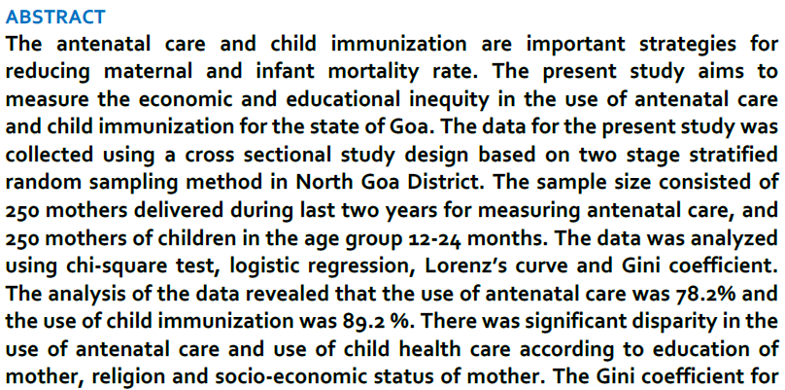
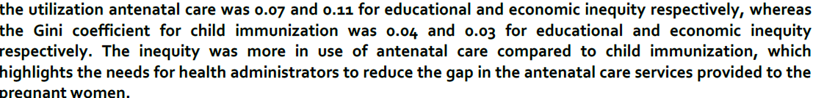
Unstructured Abstract
Source : Kulkarni MS & Nimbalkar (2015) : Socio-economic inequity in use of antenatal care and child immunization services in Goa . Global Journal of Medicine and Public Health, Vol 4 , No2,

Slide 12
INTRODUCTION
Start this section with broad statements and narrow it down further, make more specific the research problem being studied
Provide background information relevant to the selected problem & define the problem being studied.
Rationale of the study : justifying undertaken research
State the research question
Significance of the study

Slide 13
STEP I
Background information -problem
STEP II
Rationale of the study
STEP III
Research question & Significance

Slide 14
Significance
The significance of the research paper sets the study in context :
Who are being benefited from the research?
It makes clear how the how the findings of the your study will help to resolve the problem, filling gaps in the knowledge and influencing policy change.

Slide 15
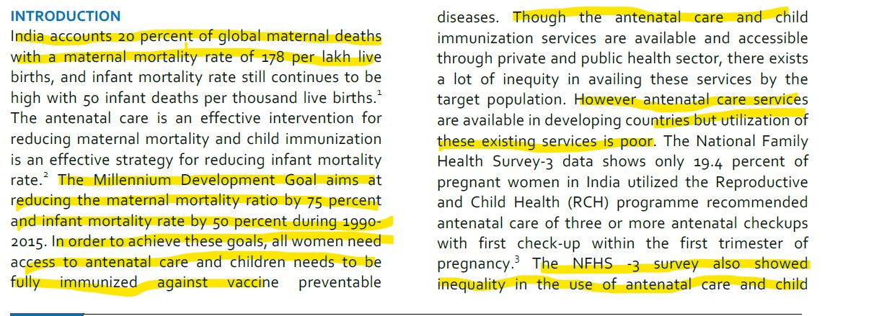

Slide 16
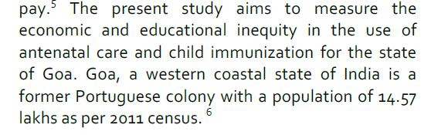
OBJECTIVES
The research problem has to be further narrowed and focused, objectives describe the expected contributions and outcomes arising from the study
SMART
Specific
Measurable
Achievable
Relevant
Time based

Slide 17
Review of Literature
Carry out exhaustive review of literature related to important issues of the research problem
What is the nature of problem ?Where did the problem come from? What is already known about the problem? What methods have been used to solve it ?
Refer to the aspects of literature, which are relevant to objective of the research study.

Slide 18
Developing a conceptual framework
Hypothesis is statement showing the anticipated relationship between two or more variables, mainly between independent and dependent variable.
State Positive or Directional hypothesis
With literature review, you will come to Know that the problem you wish to investigate has its roots in many theories. The conceptual model is representation of a system.
It is a diagramic representation showing relationship of variables.

Slide 19
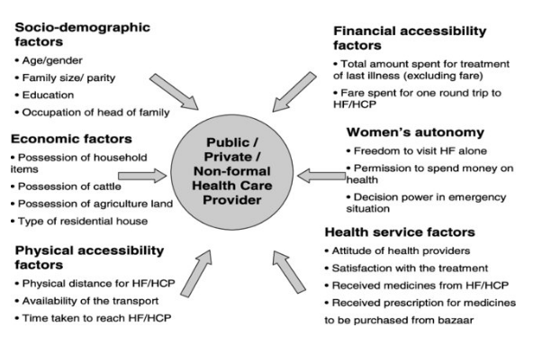
Figure : Conceptual framework of Kroger’s for studying determinates of health seeking behaviours
Source : Kroeger, A. (1983) Anthropological and socio-medical healthcare research in developing countries. Social Science and Medicine 17(3), 147–161.

Slide 20
MATERIALS & METHODS
The method section should clarify how and why study was done in a particular way & it is considered as brain the of the study. Provide all details so as to replicate the study by others. Method section should include :
Study Design
Study participants, sample size & sampling method
Data collection methods
Ethical issues
Statistical methods used for analysis

Slide 21
First identify type of study being conducted
Experimental, Quasi Experimental or Non experimental (Observational)
Descriptive or Analytical , Quantitative or Qualitative
State research Design :
Experimental study : RCT, Pre-Post Test, Factorial Design
Observational Study: Prospective , Retrospective
Cross sectional (Survey)
In Experimental study we evaluate the interventional factors such as Drug, Exercise, Counselling , Health Education, Yoga etc
Explain in detail how the participants will be recruited and allotted to different Groups to receive the interventional material.

Slide 22
Setting : School, Work place, Hospital, Community
Define your target population
Sample size ? Provide justification for sample size estimation
Ex : Based on inputs (Mean±SD or %) of similar prior study, a sample size of 145 for Treatment Group and 145 for Control Group were required in this study to be able to detect an Relative risk of stroke 2.0, with 80% power and 95% confidence at two tailed alternative.

Slide 23
How the participants selected ?
Sampling Method – Simple Random, Stratified, Systematic, Cluster
Randomization – Random Number Table/ Computer generated
Purposive sampling don’t have generalization of Results.

Slide 24
Methods of Data Collection :
Preparation of questionnaire
Testing of Reliability and validity of the questionnaire
Questionnaire – Paper / Tablet
Pilot Testing of questionnaire
Data was collected on pre designed and pretested questionnaire
Personal Interview / Postal /Telephonic / Website /Survey monkey / Google Form
Identify Variables with data measurement scales
Identify Dependent and Independent variable

Slide 25
Data Management & Statistical Analysis
Object is to explain the how the collected data was analysed ?
Which of the Statistical Methods were used ?
Don’t write appropriate statistical methods were used for data analysis.
After cleaning, the data was entered in to the MS Excel.
Later on the Data was analysed using the statistical software SPSS Version 25 / STATA / R etc.
The descriptive data was presented in the table in term of Mean±SD for quantitative variables, Number and Percent for qualitative variables.
For qualitative variables provide both numbers and %

Slide 26
Statistical Analysis :
Inferential statistics
Qualitative outcome – Chi-square, Odds Ratio, Multiple Logistic Regression
Quantitative out come : Parametric /Non Parametric Tests
Independent Student t test/ Mann-Whitney U test
Dependent Student t test / Wilcoxon’s Signed Rank test
ANOVA / Kruskal Walli’s Test
Repeated Measure ANOVA / Friedman’s Test
Correlation & Regression
Multivariate Analysis : Factor Analysis, Discriminant Analysis etc.
A p value less than 0.05 was considered statistically significant
Qualitative Research : Focus Group, Method & Number of session, Paricipants

Slide 27

RESULTS :

Slide 28
Results Section:
The results of the study are based on the analysis of data collected by you during your research study. This section is considered as heart of the research study.
Purpose of data analysis :
To answer your research question
To achieve the stated aims and objectives
To prove/refute the research hypothesis
It includes the descriptive statistics and inferential statistics.

Slide 29
Presentation of Data
Data analysis starts with presentation of data by summarizing data of all variables.
Present your results in a logical sequence in the text, tables, and diagrams, giving the main or most important findings first.
The results of the study are presented with help of text / table/ graphs and statistically significant difference between two groups (p value).
The tables & graphs have ability to summarize entire data in an intelligent format.
Avoid duplication of table & graphs.

Slide 30
Strategy for Data Analysis
Descriptive study: Present descriptive statistics – description of your data showing Mean±SD or No. & % in the form of table or graphs. Find the estimates such as Mean & percent with confidence interval.
First provide the table / Graphs for background characteristics
First perform Univariate / Bivariate Analysis
Perform multivariate analysis

Slide 31
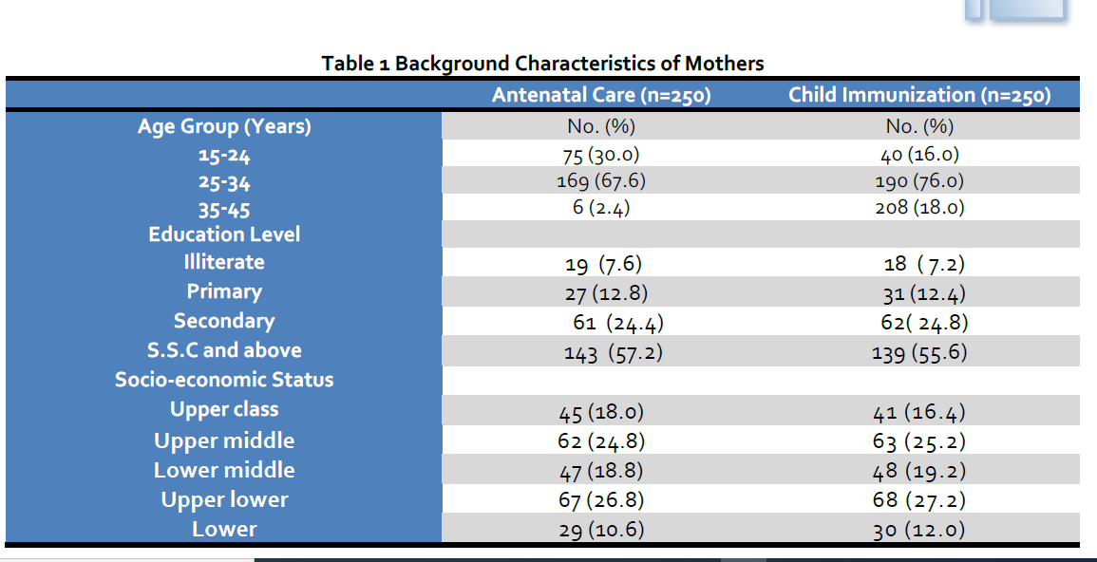

Slide 32
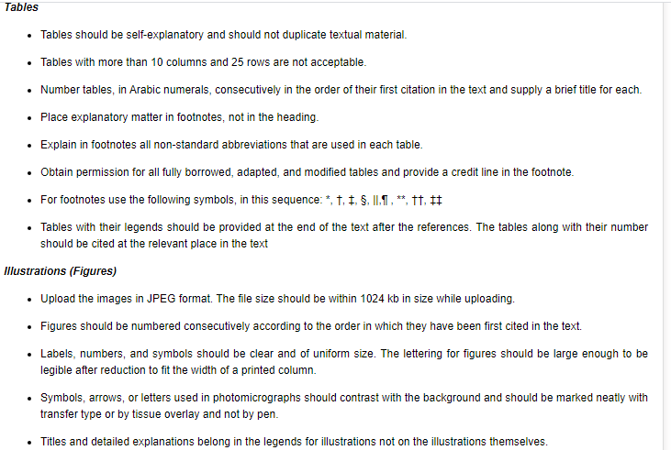

Slide 33
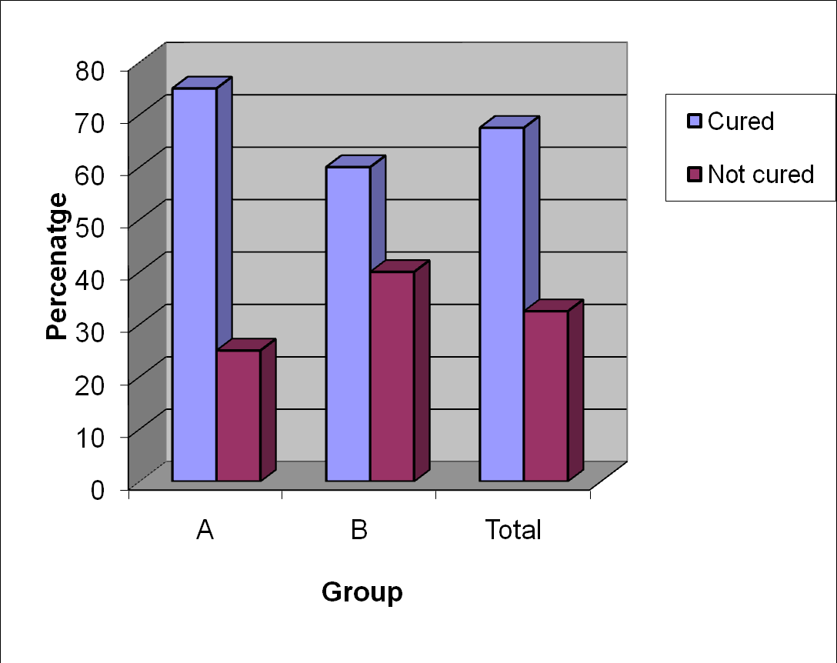
Fig 1: Multiple bar diagram showing cure rate

Slide 34
Strategy for Data Analysis
For analytical studies provide in the table related information about the variables being compared (Mean±SD in case of Normal distribution & Median and Inter Quartile Range in case of Skewed distribution) or No .& %, with 95% CI.
Then provide inferential statistics i.e. information related to p value, which includes test statistics such as values of student t test, χ2, degree of freedom or measuring strength of association between two variables.
Use upper italics (P 0.048). For all P values include the exact value and not less than 0.05 or 0.001.

Slide 35
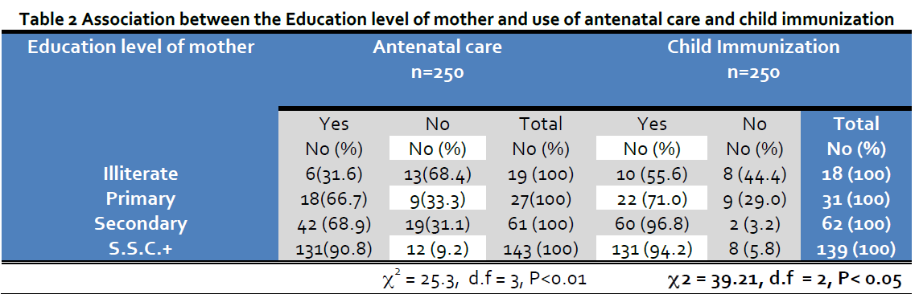
* Take proper Denominator while calculating percent
Provide Short description of the table

Slide 36
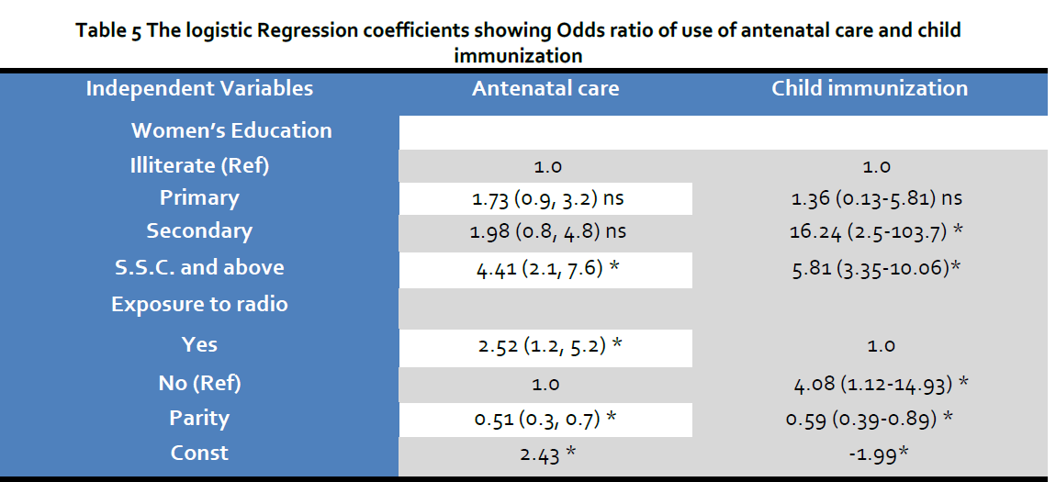

Slide 37
Table for more than two Mean & SD
Table 4 : Mean±SD of salary and age of employees of company A and B
Parameter | Company A Mean±SD | Company B Mean±SD | P value
Monthly salary(000) | 124 ±12 | 154 ± 14 | t=?, df=? P<0.05, Sign
Age years | 28 ± 5 | 32 ± 6 | t=?, df=? P<0.01, Sign

Slide 38
Discussion :
Include summary of key findings (primary outcome measures, secondary outcome measures, results as they relate to a prior hypothesis);
Strengths and limitations of the study (study question, study design, data collection, analysis and interpretation);
Interpretation and implications in the context of the totality of evidence (is there a systematic review to refer to, if not, could one be reasonably done here and now?
what this study adds to the available evidence, effects on patient care and health policy, possible mechanisms);
Controversies raised by this study; and Future research directions (for this particular research collaboration, underlying mechanisms, clinical research).

Slide 39
Discussion Section:
Answer the question posed in the introduction
Then explain how the answer fits in (or does not fit in) with other published results
Put the results into context.
Do not repeat in detail data or other material given in the Introduction or the Results section..

Slide 40
Do’s & Don’t of Discussion
Include in Discussion
State main findings of the study
Explain the meaning of importance
Relate the findings to similar studies
Consider alternative explanations
State the relevance of the findings
Acknowledge the limitations
Make suggestion for further research
Don’t Include in Discussion
Drawing conclusion beyond study
Unwarranted speculations
Inflations of the important findings
Conclusions that are not supported
Source :Hess Dean R (2004)

Slide 41
Limitation of Research study :
No Research study is perfect or flawless
The limitations of a study are its flaws or shortcomings
Due to unavailability of resources, small sample size, flawed methodology, etc.
Measurement or data collection problem
Data collected is not representative (purposive sampling) to generalize the results

Slide 42
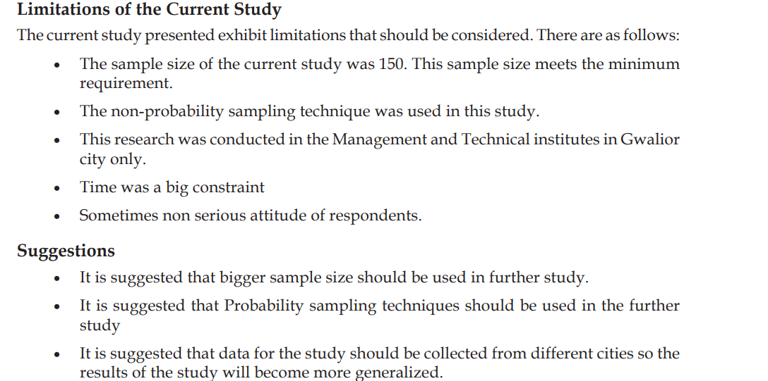
Limitations of the study :
Source :Quality of Work Life and Job Satisfaction in Print Media Garima Mathur, Richa Banerjee, Chanda Gulati, Sanjay Kant Prasad, Priyadarshini Nagori, Anuj Bansal, Archana Singh, Monika Jain, Shilpi Upadhyay, Megha Salunke, and Anushruti .2016.Psycholgy

Slide 43
Conclusion Section:
It should provide a brief summary of the results & should be more than a summary.
Goal is to provide the most general claims that can be justified by the evidence.
It should provide the key message of the author
Don’t repeat abstract, introduction
Conclusion should answer all research question stated in introduction

Slide 44
Reference Section :
About 30 references can be included.
Follow the style of the journal, APA, Vancouver , Howard etc.
Use reference management software Mendeleye, Endnote
References has to be formatted correctly according to guidelines
Include latest references
These articles generally should not have more than six authors.

Slide 45
Title :
Title of the article should be short, continuous and sufficiently descriptive and informative , useful in indexing and information retrieval.
Avoid to long title, Should not contain more than 15 words,
Avoid abbreviations in Title
Declarative title
Connect Title with Experiment, outcome, subjects
In concise way provide relevant information about your work
Contain keywords, Descriptive phrase

Slide 46
AUTHORSHIP
Authorship credit should be based only on substantial contributions to each of the three components mentioned below:
Concept and design of study or acquisition of data or analysis and interpretation of data;
Drafting the article or revising it critically for important intellectual content; and
Final approval of the version to be published.
(Indian Journal of Medical Research)

Slide 47
Focus :
Style of writing
Grammar
Plagiarism : Using some other person's ideas and information without acknowledging that specific person as the source.

Slide 48

Reviewers Focus :
Completeness of Abstract
Originality of work
Importance of subject
Scientific reliability
Ethical Issues
Experimental/Research methods
Results, Figures & tables
Relevance of discussion
Conclusion & interpretation
References
Presentation & Writing style

Slide 49
References:
Chris A Mack (2018). How to writ Good A Scientific Paper. Spie Press, USA.
Hess Dean R (2004). How to write an effective discussion. Respir Care; 49(10):1238–1241
Stephen B Hulley , S Cummings, et al. (2007).Designing Clinical Research, 4th edition, Lippincott Williiam & Wilkins
Indayan A. (2016). Basic Methods of Medical Reearch.#rd Edition. AITBS Publishers, India.

Slide 50
THANK YOU

